Slide 1
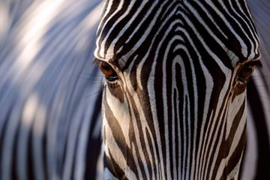
TEXTURE ANALYSIS
Class 9: Computational Vision

Slide 2
Index
What is a texture in an image?
Computational methods
Gaussian Filters
Applications

Slide 3
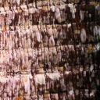
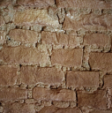
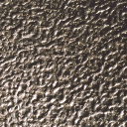
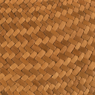
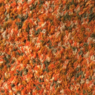

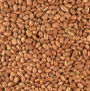
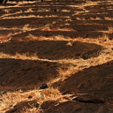
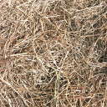

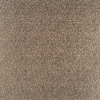

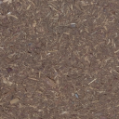
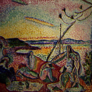
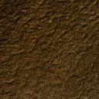
What textures do you know?
What does define a texture?

Slide 4
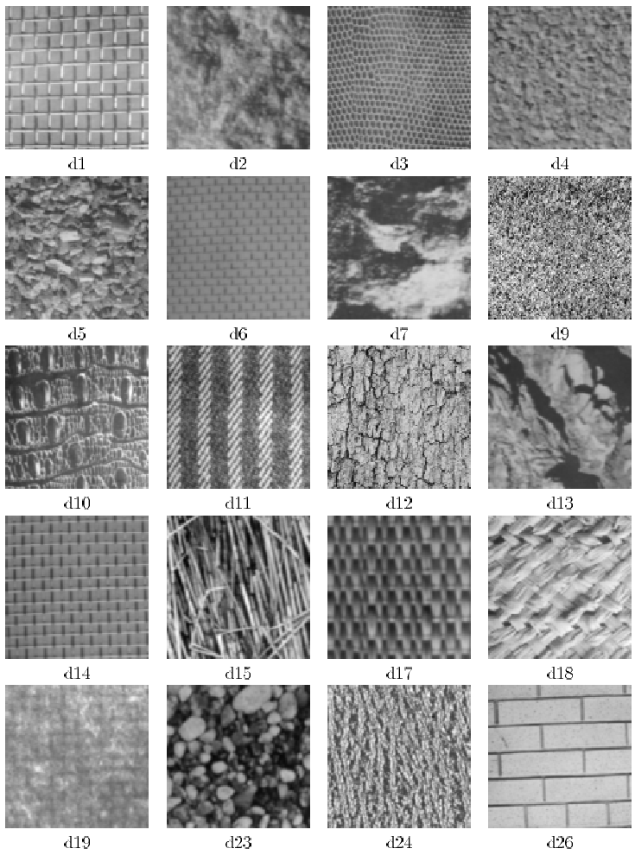
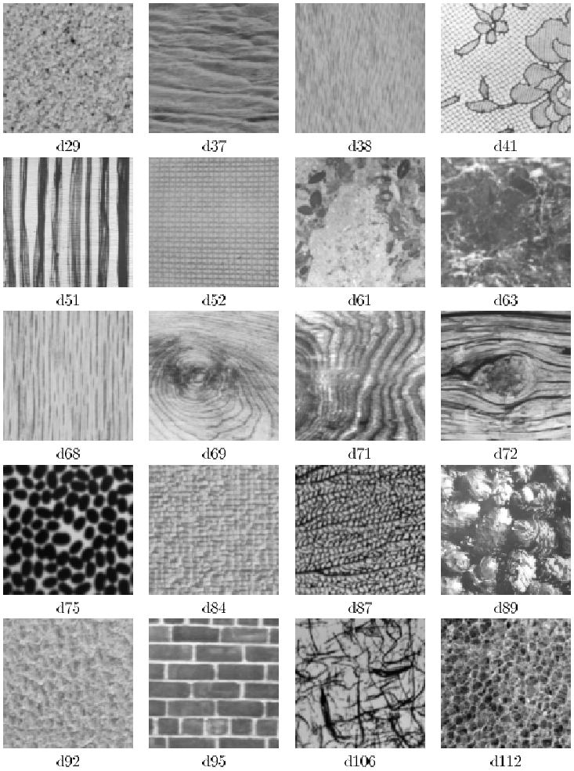
What textures do you know?
P. Brodatz. Textures: A Photographic Album for Artists and Designers. Dover, NY, 1966

Slide 5
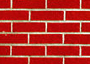

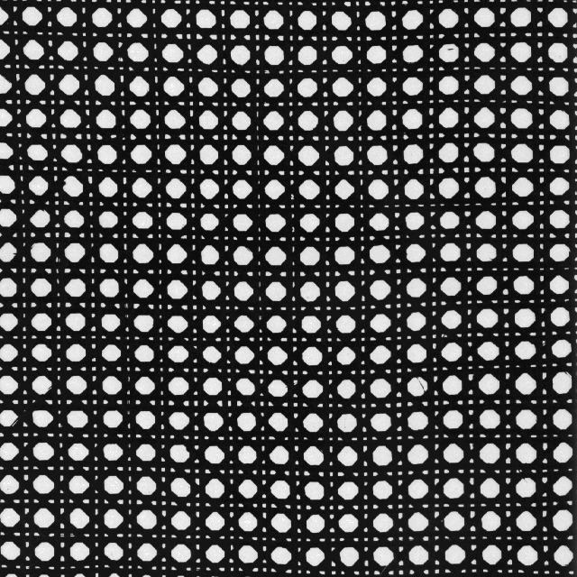
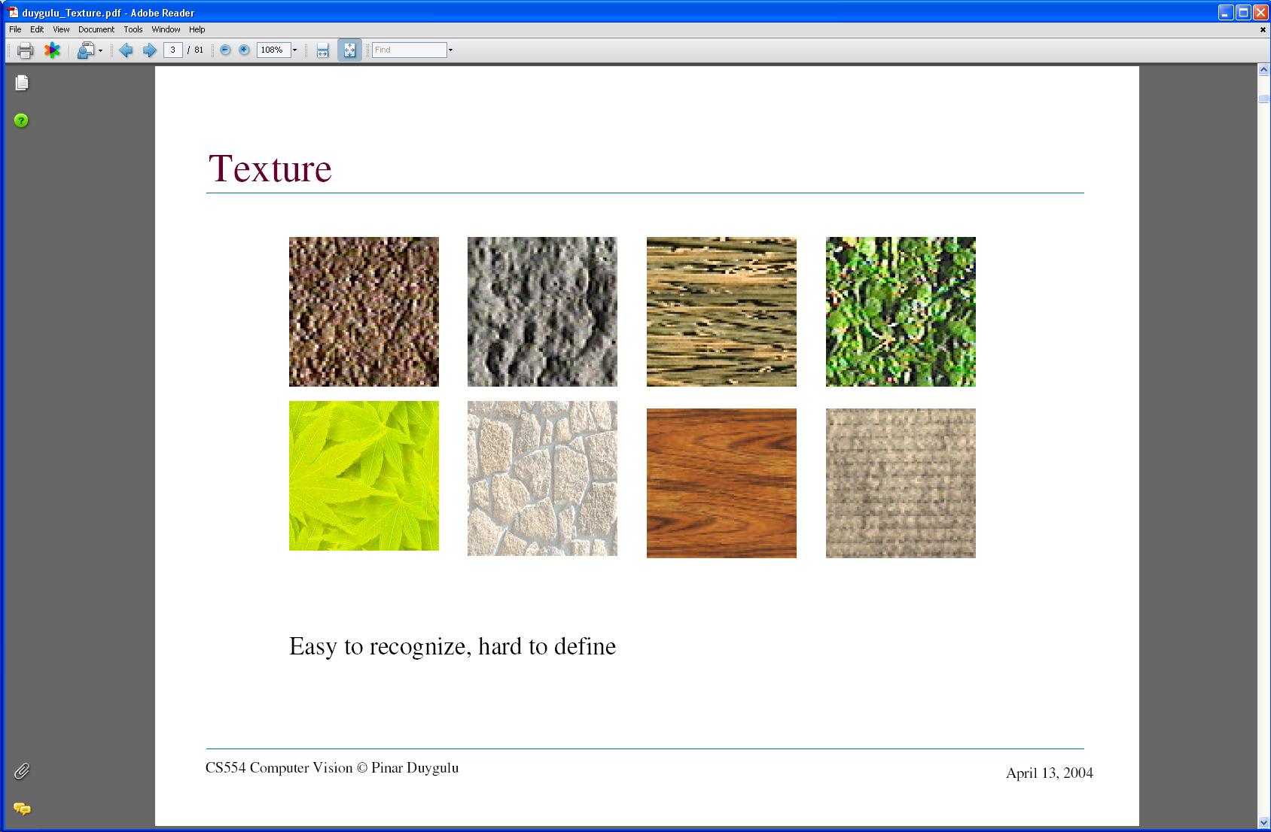
Includes: more regular patterns
Includes: more random patterns

Slide 6
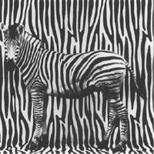
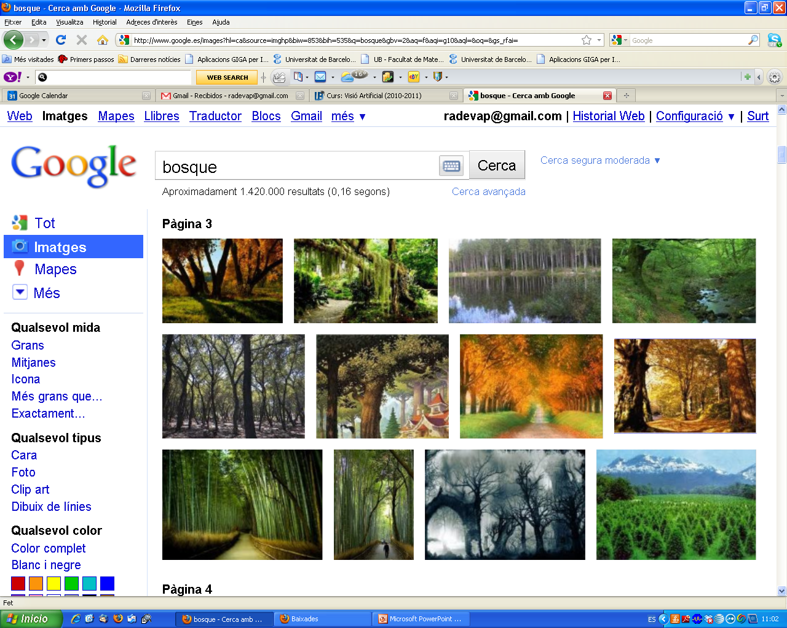

Why shell we use texture analysis?
Automatic analysis and perception of textures
Image classification
Image Segmentation
Object recognition
Perception of surface orientation, etc.

Slide 7
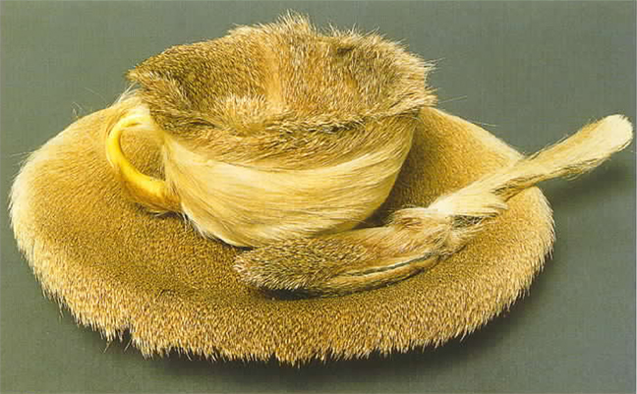
What applications can be defined for the texture analysis?
Defect Inspection
- textile
- cork
- Wooden furniture
- ceramic
- skin
Analysis of scenes
Improved images and photos
- Printers, cameras
Texture syntesis
Petia Ivanova Radeva
Artificial Vision
7
Notes:
7

Slide 8
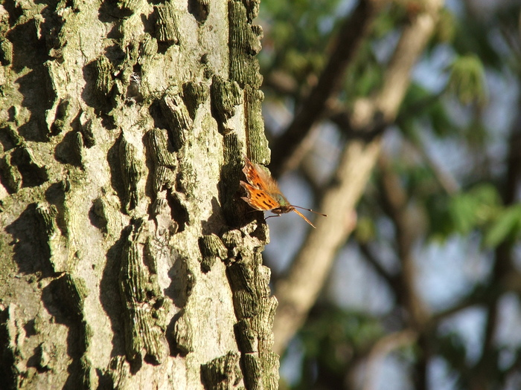
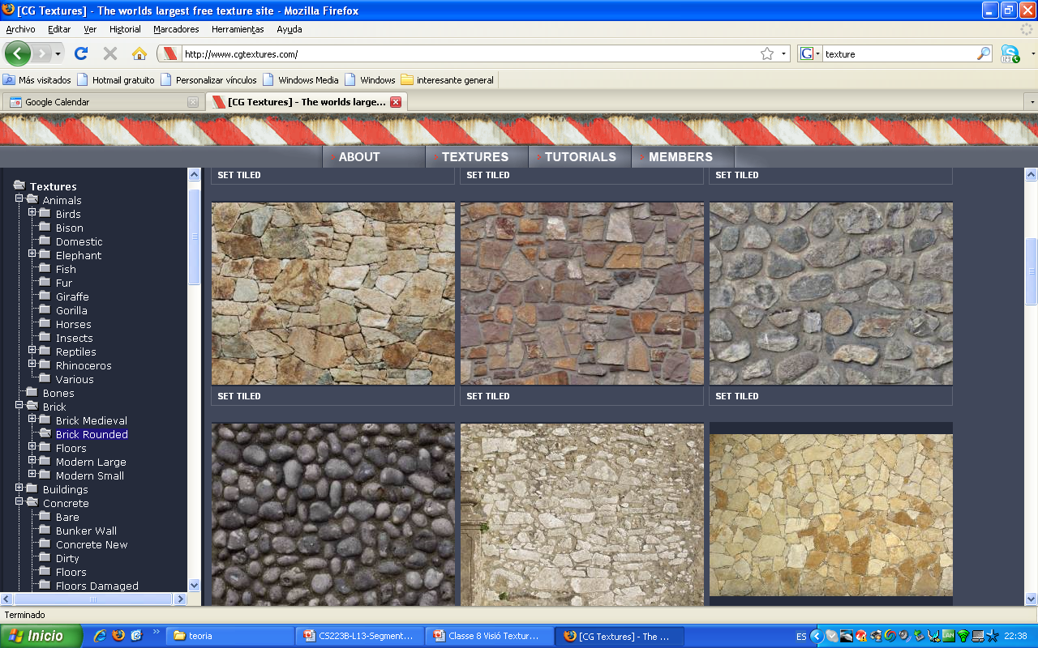
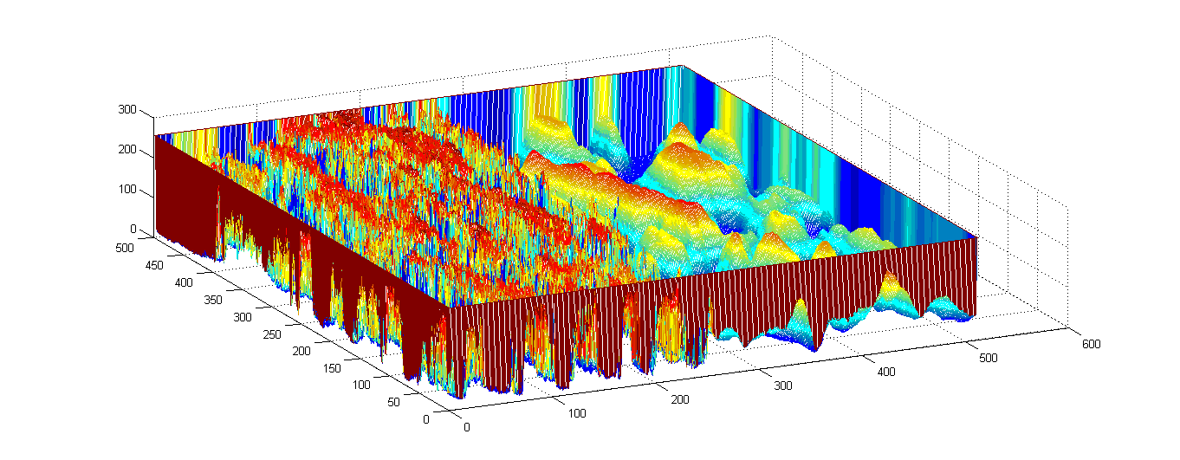
What is a texture?
Visual texture - when the uniformity of the region is perceived as a series of variations in the intensity.
Causes of the visual texture appearance:
Changes in reflectance.
Changes in the micro-orientation of a surface.
Relevance: source of information about the scene, useful for certain visual processes (segmentation and perception of orientation).

Slide 9
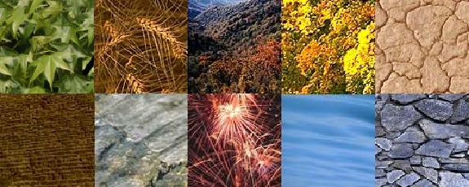
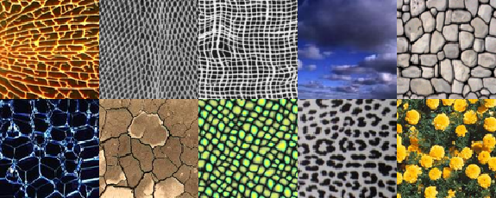
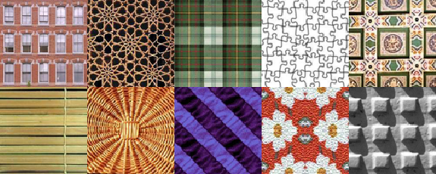
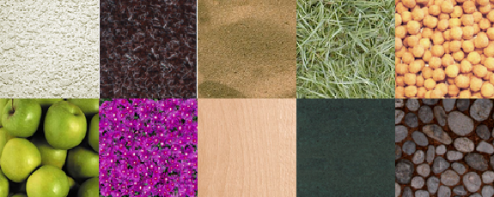
Types of textures
Examples of natural textures.
Examples of weakly-homogeneous textures.
Examples of artificial regular textures.
Examples of stochastic textures.
Notes:
12/3/17
9

Slide 10

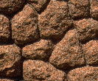
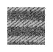
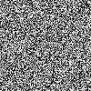
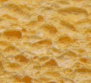
What is a texture?
Types: many, it depends on the criteria: structured, unstructured, etc.
Three general groups:
structured,
stochastic and
mixed.
How are they formed?
Stochastic
patterm
Repetitive
or structured
pattern
A mix of both
When a texture is distinguishable even if it has the same lighting, color and contrast?
Notes:
12/3/17
10

Slide 11
Index
What is a texture in an image?
Computational methods
Gaussian Filters
Applications

Slide 12
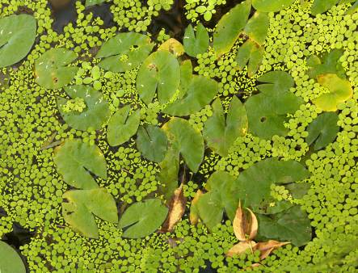
Computational methods for texture discrimination
Assumptions
Texture (stochastic and structural) is a property of regions:
- contextual property;
- description of the distribution of gray levels in regions more or less extensive.
The texture can be perceived at different scales or levels of
resolution.
A region presents a texture when the number of primitive
patterns is large (not easily countable).

Slide 13
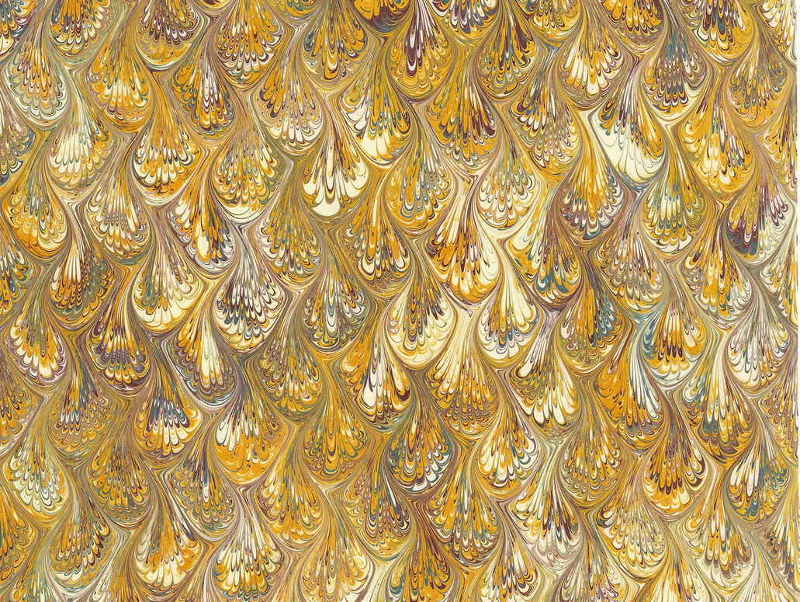
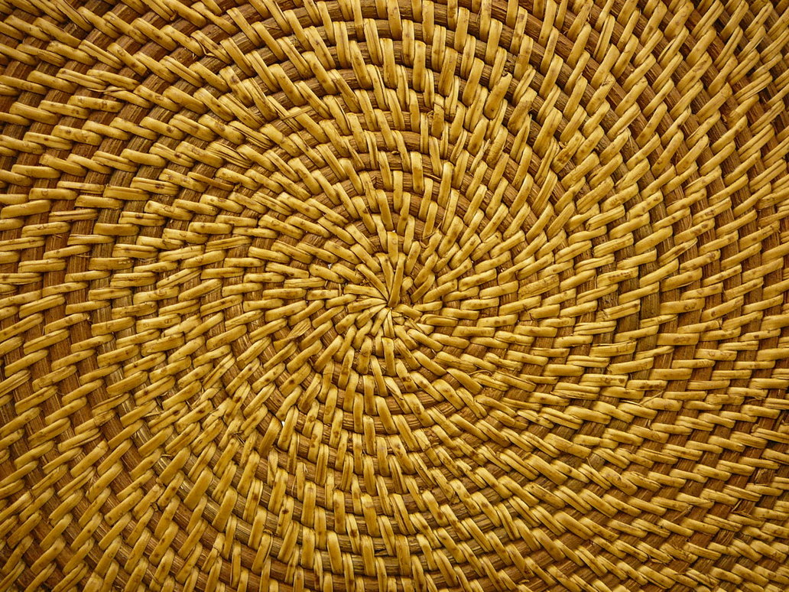
Texture representation
Assumptions
Consider textures as made up of repeated local patterns, so:
1. Find the patterns
Use filters that look like patterns (spots, bars, raw patches…)
Consider magnitude of response
2. Describe their statistics within each local window
Mean, standard deviation
Histogram
Histogram of “prototypical” feature occurrences (textons)
Kristen Grauman

Slide 14
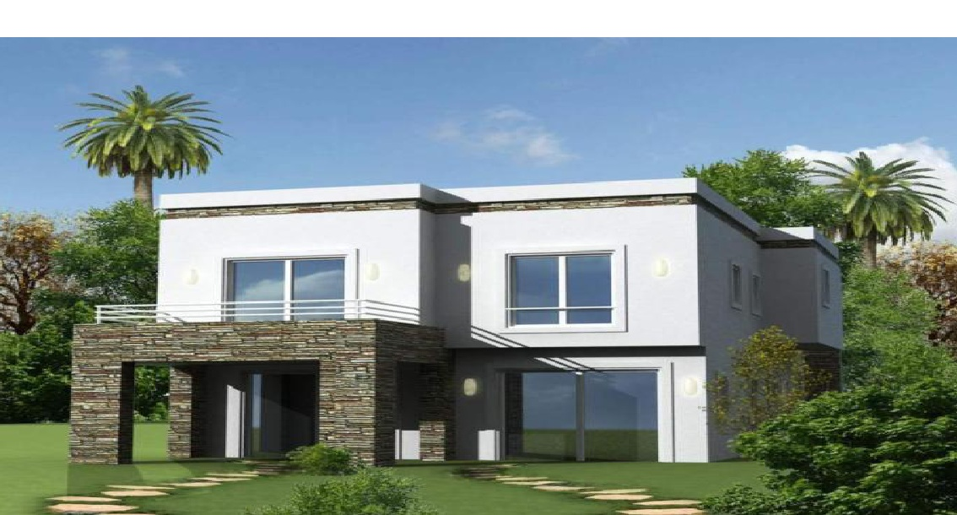
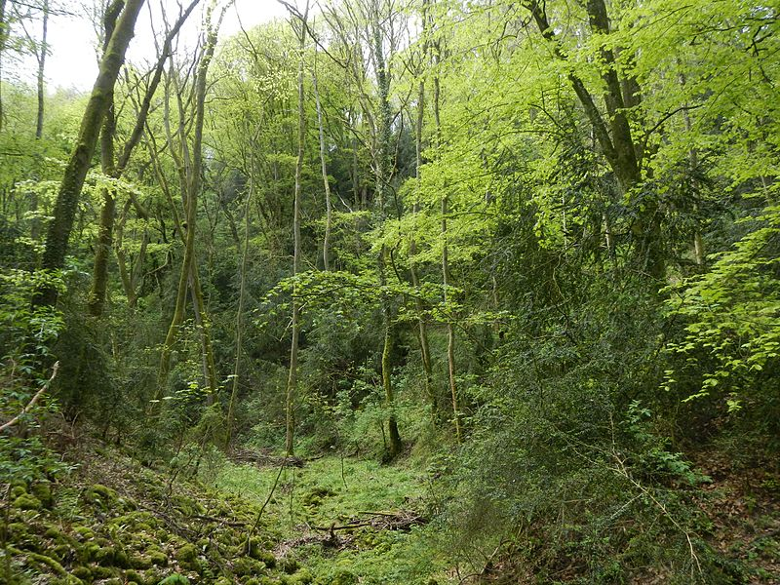
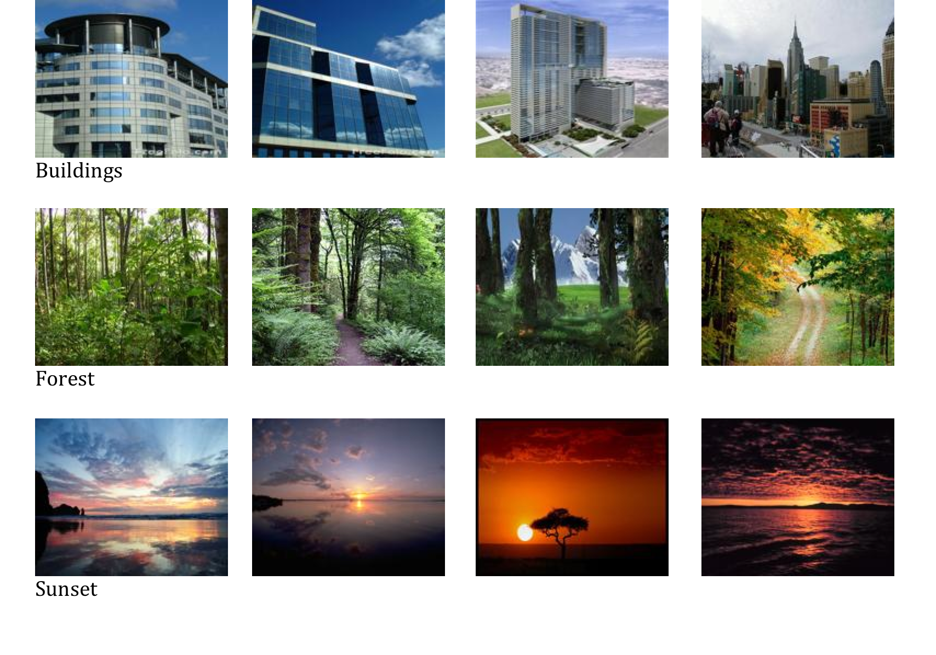
What kind of filters to use?
Different textures have different attributes -> we need different filters!

Slide 15
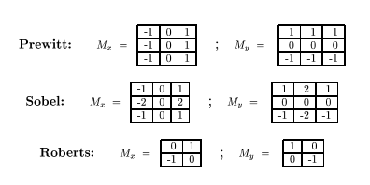
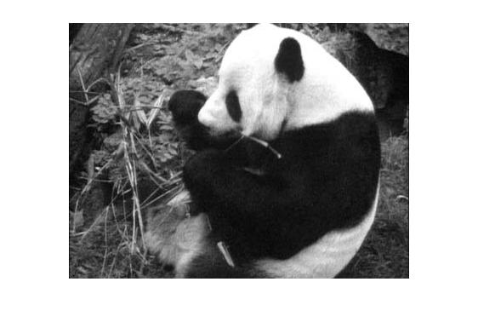
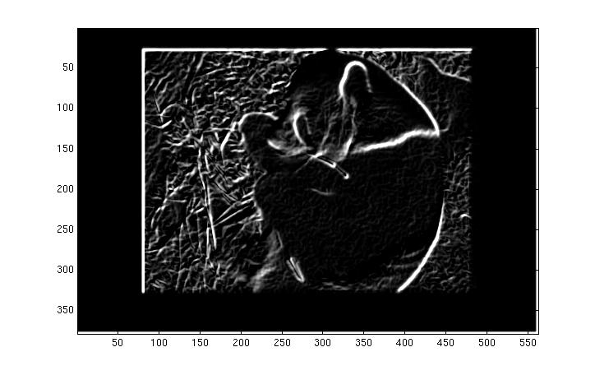
Recall
We looked for edges convolving with filters like:
Derivatives of
of Gaussians
Convolution filters (kernels) are “imitations” of structures we are looking for.

Slide 16
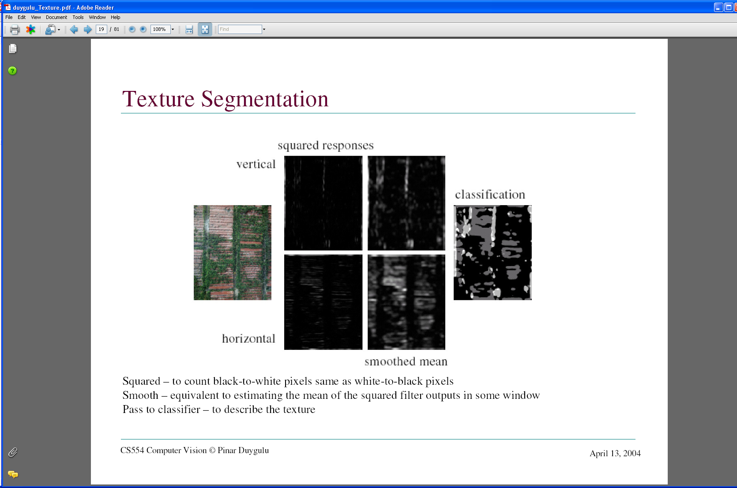
Texture representation: example
 | mean d/dx value | mean d/dy value
Win. #1 | 4 | 10
original image
…
statistics to summarize patterns in small windows
derivative filter responses, squared
Kristen Grauman

Slide 17
Texture representation: example
 | mean d/dx value | mean d/dy value
Win. #1 | 4 | 10
Win.#2 | 18 | 7
original image
…
statistics to summarize patterns in small windows
derivative filter responses, squared
Kristen Grauman

Slide 18
Texture representation: example
 | mean d/dx value | mean d/dy value
Win. #1 | 4 | 10
Win.#2 | 18 | 7
Win.#9 | 20 | 20
original image
…
…
statistics to summarize patterns in small windows
derivative filter responses, squared
Kristen Grauman

Slide 19
Texture representation: example
 | mean d/dx value | mean d/dy value
Win. #1 | 4 | 10
Win.#2 | 18 | 7
Win.#9 | 20 | 20
Dimension 2 (mean d/dy value)
Dimension 1 (mean d/dx value)
…
…
statistics to summarize patterns in small windows
Kristen Grauman

Slide 20
Texture representation: example
Windows with primarily horizontal edges
Both
 | mean d/dx value | mean d/dy value
Win. #1 | 4 | 10
Win.#2 | 18 | 7
Win.#9 | 20 | 20
Dimension 2 (mean d/dy value)
Dimension 1 (mean d/dx value)
…
…
Windows with small gradient in both directions
Windows with primarily vertical edges
statistics to summarize patterns in small windows
Kristen Grauman

Slide 21
Texture representation: example
original image
visualization of the assignment to texture “types”
derivative filter responses, squared
Kristen Grauman

Slide 22
Texture representation: example
 | mean d/dx value | mean d/dy value
Win. #1 | 4 | 10
Win.#2 | 18 | 7
Win.#9 | 20 | 20
Dimension 2 (mean d/dy value)
Far: dissimilar textures
Close: similar textures
Dimension 1 (mean d/dx value)
…
…
statistics to summarize patterns in small windows
Kristen Grauman

Slide 23
Texture representation: example
Dimension 2
Dimension 1
Kristen Grauman
Notes:
23

Slide 24
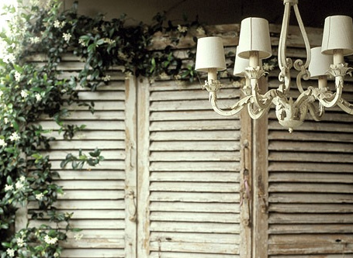
Texture representation: example
Dimension 2
Dimension 1
Distance reveals how dissimilar texture from window a is from texture in window b.
If the whole image contains the same texture, what would be the feature space representation looks like?
Kristen Grauman
Notes:
24

Slide 25
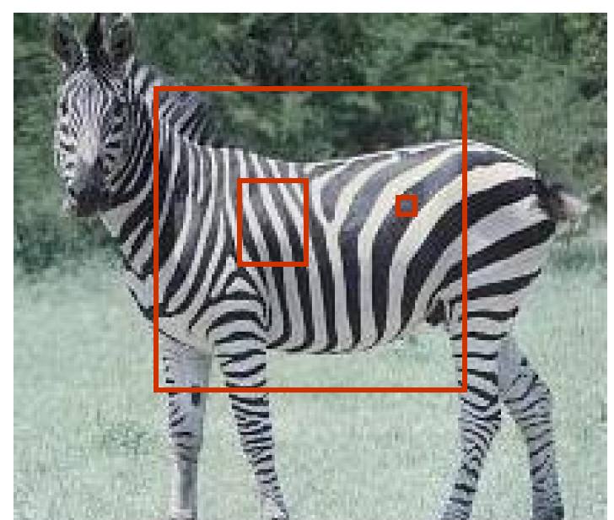
Texture representation: window scale
We’re assuming we know the relevant window size for which we collect these statistics.
Possible to perform scale selection by looking for window scale where texture description is not changing.

Slide 26
Filter banks
Our previous example used two filters, and resulted in a 2-dimensional feature vector to describe texture in a window.
x and y derivatives revealed something about local structure.
We can generalize to apply a collection of multiple (d) filters: a “filter bank”.
Then our feature vectors will be d-dimensional.
still can think of nearness, farness in feature space.

Slide 27
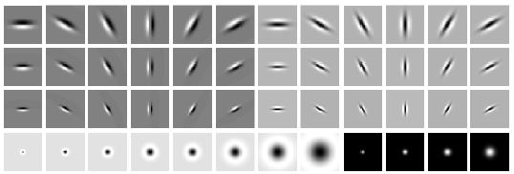
Filter banks
What filters to put in the bank?
Typically, we want a combination of scales and orientations, different types of patterns.
orientations
scales
“Edges”
“Bars”
“Spots”
Matlab code available for these examples:
http://www.robots.ox.ac.uk/~vgg/research/texclass/filters.html

Slide 28
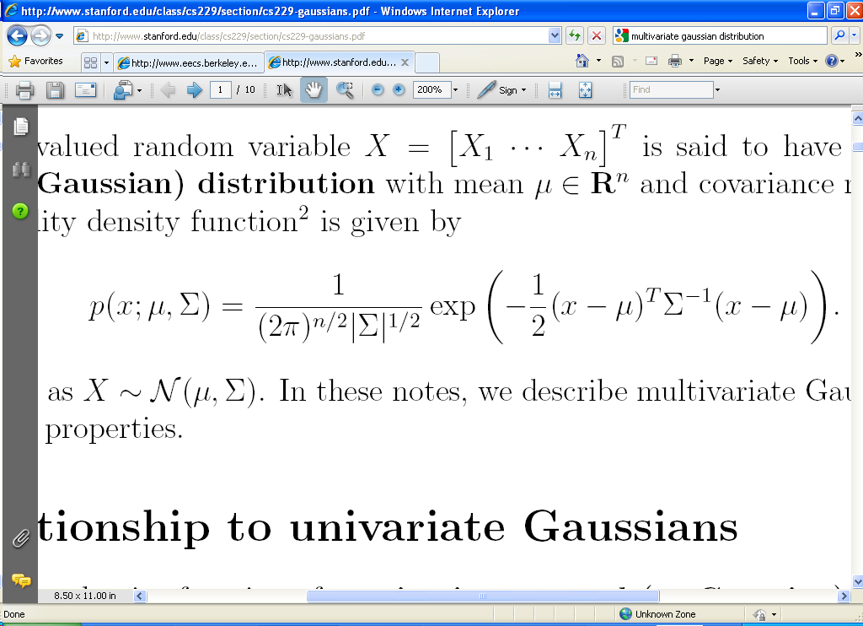
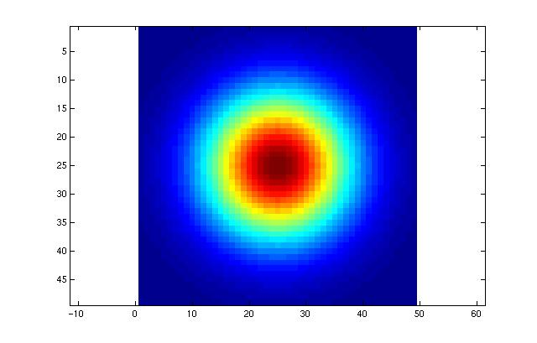
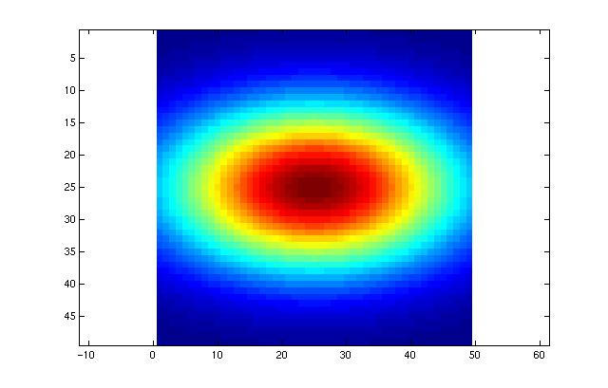
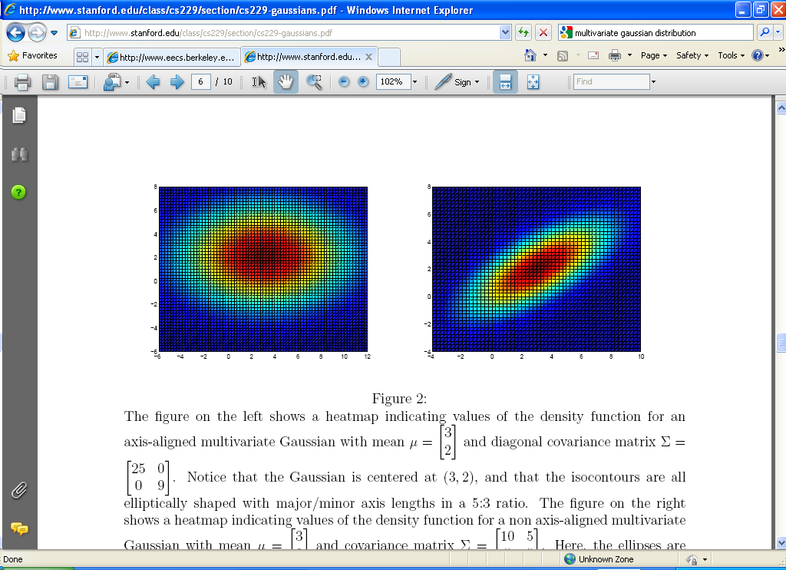
How to generate filters: using a Gaussian function
Matlab code available for these examples:
http://www.robots.ox.ac.uk/~vgg/research/texclass/filters.html

Slide 29
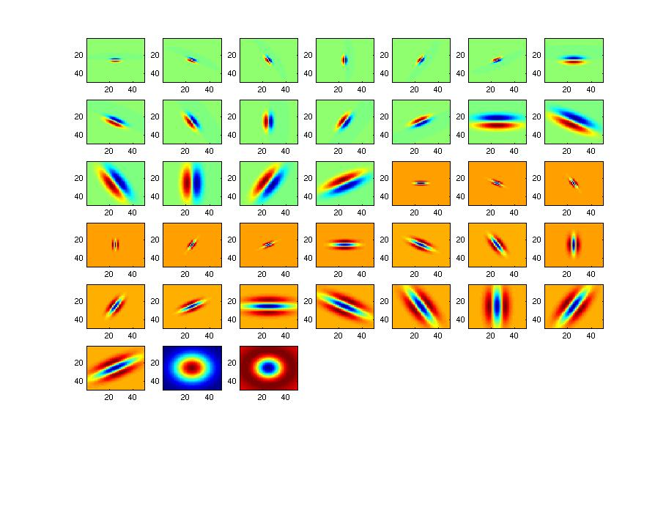
Filter bank
Matlab code available for these examples:
http://www.robots.ox.ac.uk/~vgg/research/texclass/filters.html

Slide 30

Image from http://www.texasexplorer.com/austincap2.jpg
Kristen Grauman

Slide 31


Showing magnitude of responses
Kristen Grauman

Slide 32


Kristen Grauman
Notes:
2

Slide 33


Kristen Grauman
Notes:
3

Slide 34


Kristen Grauman
Notes:
4

Slide 35


Kristen Grauman

Slide 36


Kristen Grauman
Notes:
6

Slide 37


Kristen Grauman
Notes:
7

Slide 38


Kristen Grauman
Notes:
8

Slide 39


Kristen Grauman
Notes:
9

Slide 40


Kristen Grauman
Notes:
10

Slide 41


Kristen Grauman
Notes:
11

Slide 42


Kristen Grauman
Notes:
12

Slide 43


Kristen Grauman
Notes:
13

Slide 44


Kristen Grauman
Notes:
14

Slide 45


Kristen Grauman
Notes:
15

Slide 46


Kristen Grauman
Notes:
16

Slide 47


Kristen Grauman

Slide 48


Kristen Grauman
Notes:
18

Slide 49


Kristen Grauman

Slide 50

How to recover the image with the most similar texture?
Kristen Grauman

Slide 51
…….
We can form a feature vector from the list of responses at each pixel.
[r1, r2, …, r38]
…….
[r1, r2, …, r38]
Kristen Grauman

Slide 52
How to go from pixel representation to image representation?
…….
[r1, r2, …, r38]
…….
[r1, r2, …, r38]
A simple way to represent the whole image is to get the mean abs value of each feature:
I -> f(I)=[mean_{all pixels}(|r1|), mean_{all pixels} (|r2|), …, mean_{all pixels} (|r38|)]

Slide 53
How to recover the image with the most similar texture?
We are looking for the minimal Euclidean distance (L₂) between the feature vectors (f(I)) of the query image and the database images.
Kristen Grauman

Slide 54






Exercise: Can you match the texture to the response?
Filters
A
1
B
2
C
3
Mean abs responses
Derek Hoiem

Slide 55
Exercise: Representing texture by mean abs response
Filters
Mean abs responses
Is the Gaussian filter-based texture recognition contrast invariant?
Derek Hoiem

Slide 56
Index
What is a texture in an image?
Computational methods
Gaussian Filters
Applications

Slide 57





Shape from texture
Use deformation of texture from point to point to estimate surface shape
Pics from A. Loh: http://www.csse.uwa.edu.au/~angie/phdpics1.html

Slide 58

Textures and Orientation
The geometric variations of a surface produce three effects on the elements of texture:
Change in the density of the elements.
Foreshortening, or change in size due to perspective.
Rescaling.
The foreshortening is only caused by the orientation of the surface!!!
Idea: The foreshortening can be characterized by changes in the local distribution of the contour orientation of the textons.

Slide 59

Classifying materials, “stuff”
Kristen Grauman
Figure by Varma & Zisserman

Slide 60

Segmenting aerial imagery by textures
Kristen Grauman
http://www.airventure.org/2004/gallery/images/073104_satellite.jpg

Slide 61
Texture synthesis
Goal: create new samples of a given texture.
Many applications: virtual environments, hole-filling, texturing surfaces, etc.

Slide 62


Synthesizing textures when constructing 3D models of archaeological sites
A. Zalesny et al., Realistic Textures for Virtual Anastylosis

Slide 63
Summary
Texture is a useful property that is often indicative of materials, appearance cues.
Texture representations attempt to summarize repeating patterns of local structure.
Filter banks useful to measure redundant variety of structures in local neighborhood.
Feature spaces can be multi-dimensional.
A lot of texture applications to other CV problems and real applications.

